Slide 1
NSAA
Scavenger log

Slide 2
Mar 4 2020
Zane: a pencil, 6 wildcash, purple Dixon Ticonderoga pencil
Harrison: two pencils, two wildcash, one clickable plastic metal pen, one free cookie pass
Rahat: 3 mechanical pencils with lead

Slide 3
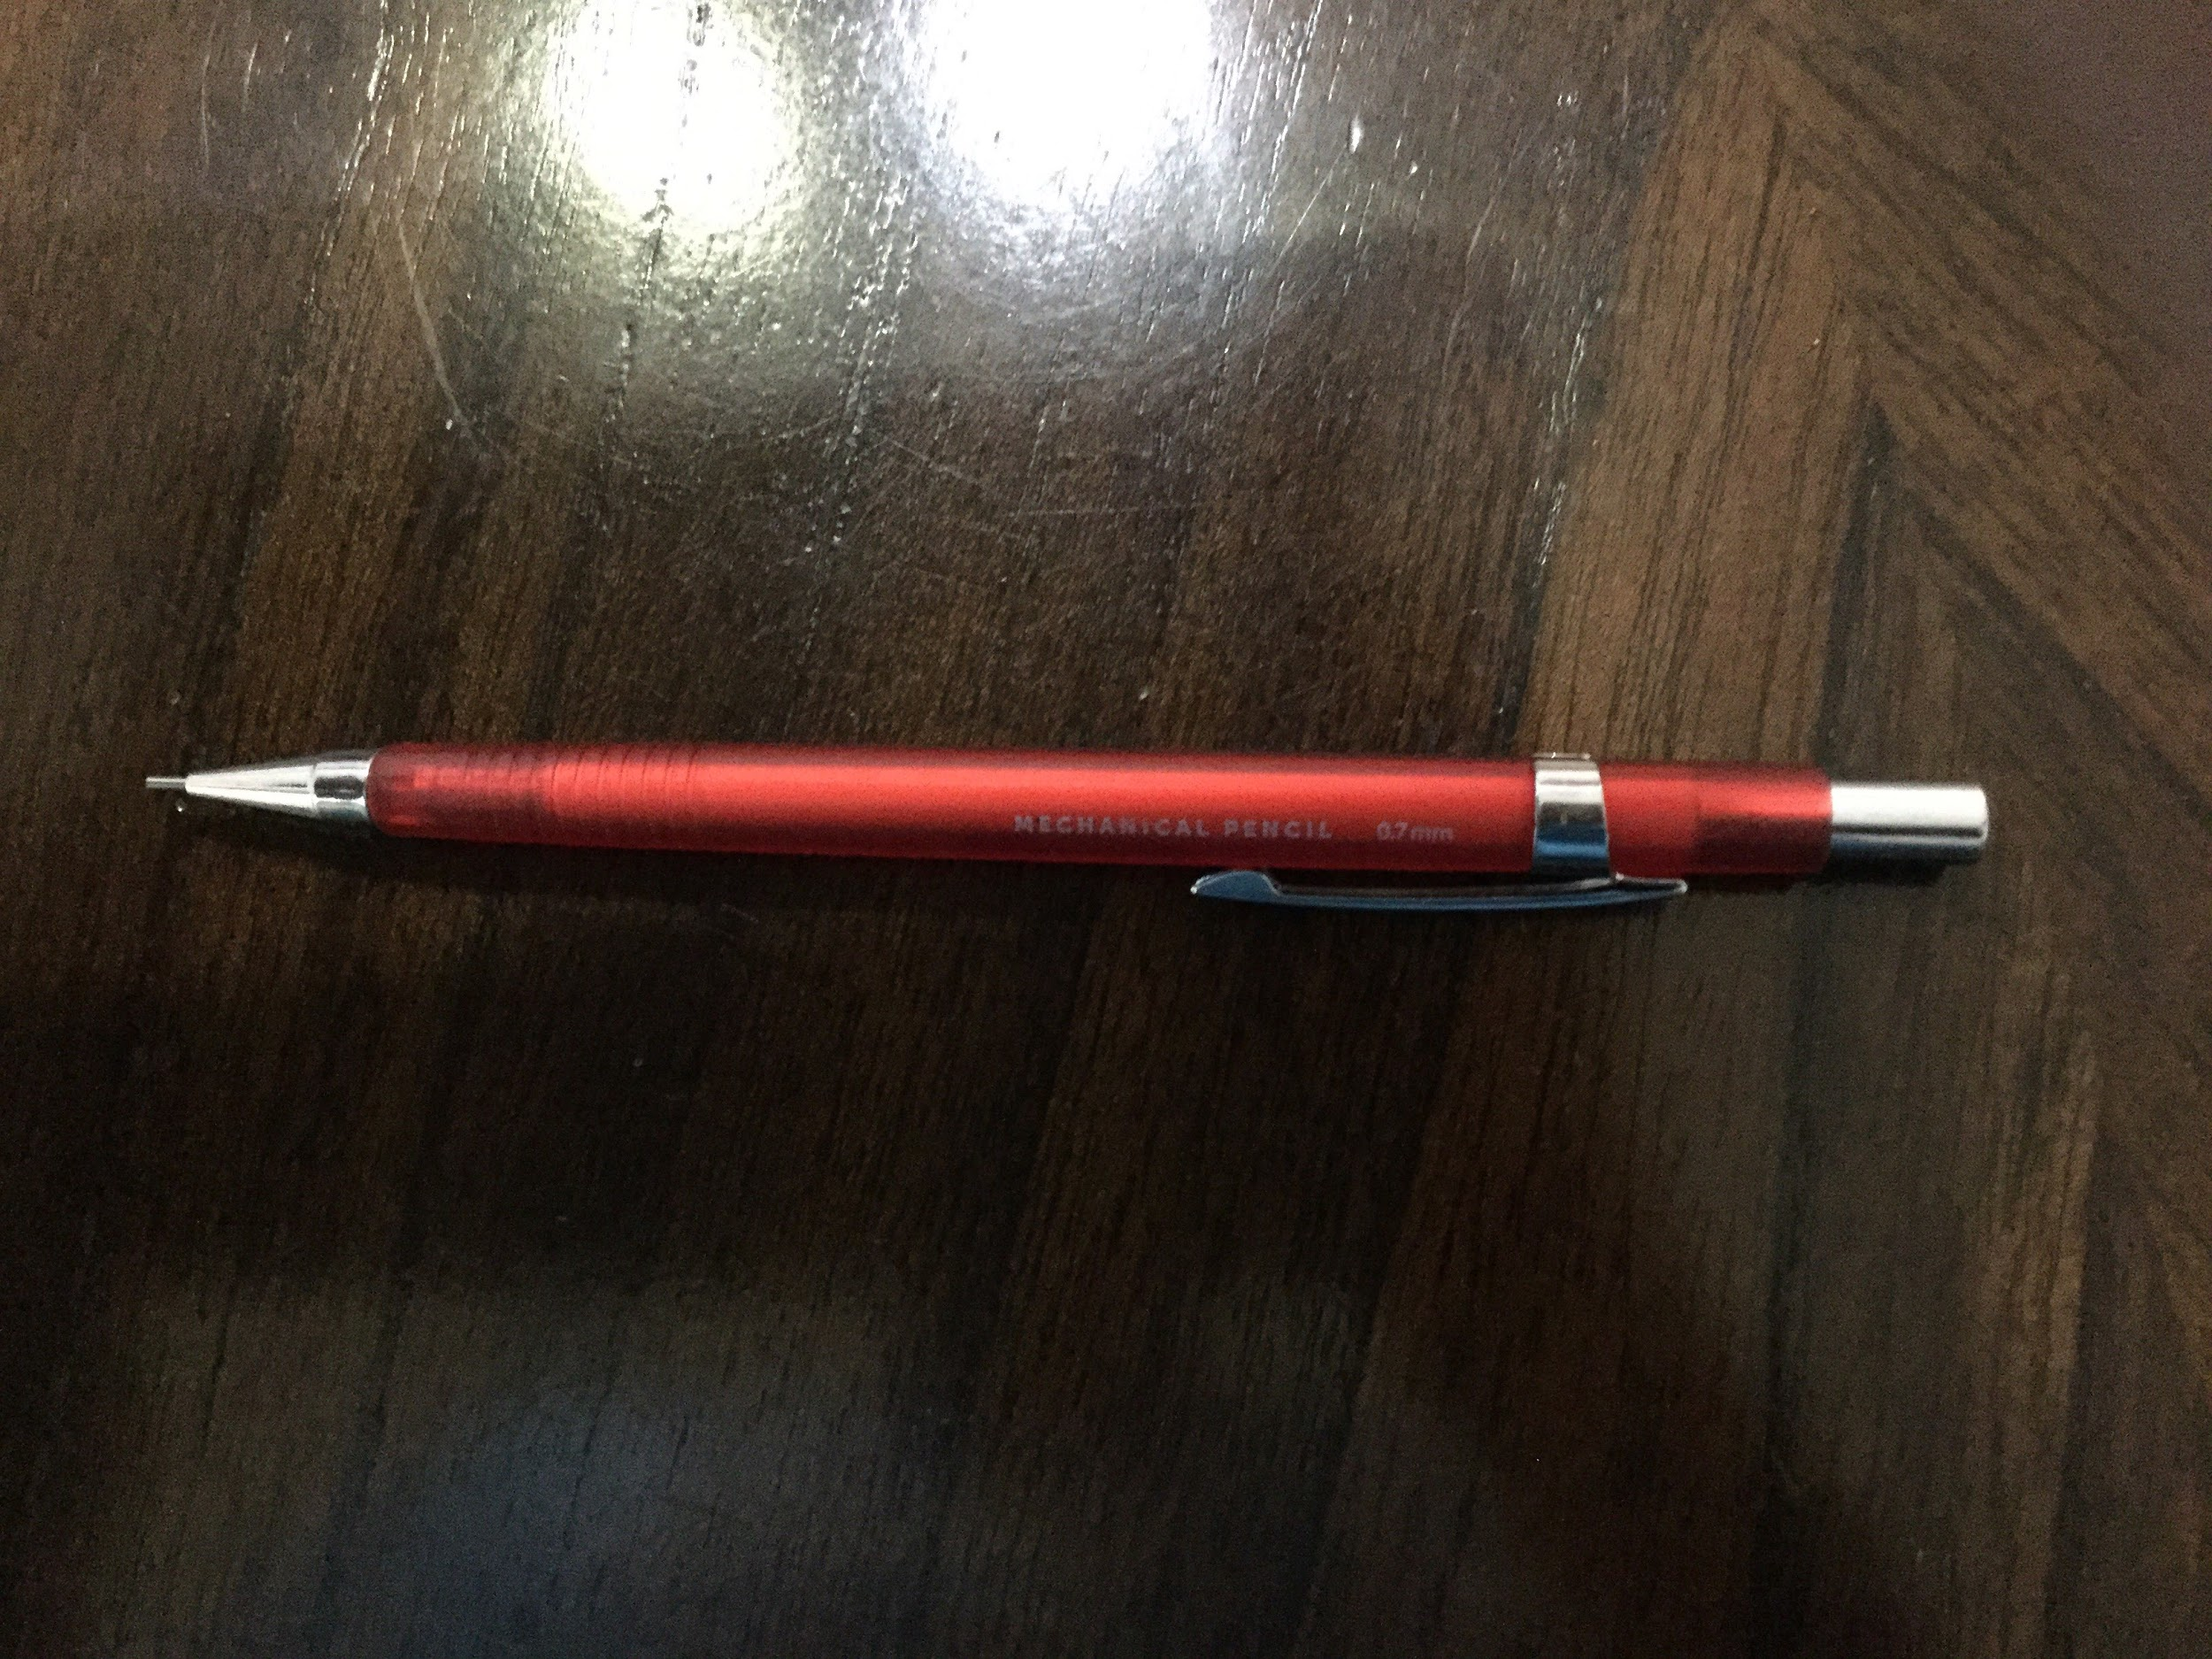
Mar 5 2020
Zane: USA titanium pencil, special pencil, one wildcash , one Papermate mechanical pencil with no lead. One normal mechanical pencil with lead. One South Gate gator pencil. One mirado black warrior pencil. One Dixon oriole pencil.
Harrison: 2 wildcash, one neon green plastic pen
Rahat: one mechanical pencil with lead that looks really cool

Slide 4
Mar 6 2020
Zane: one wildcash from trash backpack. One Dixon oriole pencil. One white pencil. One clickable large plastic pen. One Dixon Ticonderoga black pencil.
Harrison: three wildcash. Hand sanitizer. One big mechanical pencil
Jarad: one skinless pencil
Rahat: one car bookmark
Kyrillos: two wildcash.

